Slide 1
JOB ORDER CONTRACTING FUNDAMENTALS
TM
LEAN Construction & Efficient Project Delivery for
Renovation, Repair, Maintenance, Sustainability, & Minor New Construction

Slide 2
Table of Contents
Definition of Job Order Contracting
Glossary – Job Order Contracting
Key Characteristics of JOC & LEAN Construction
Levels of Collaboration
JOC Users
Considerations when Implementing a Job Order Contract
Uses for JOC
Benefits of JOC
Workflow - A Typical Project, Task/Job Order Process
Initial Scoping & SOW Development
JOC Estimating
JOC Coefficient
Lessons Learned – Do’s & Don’ts
Owner’s Role
Contractor’s Role
Contact Information

Slide 3
Definition of Job Order Contracting
A collaborative project delivery method (also termed an Alternative Project Delivery Method or Integrated Project Delivery Method) using an Indefinite Delivery, Indefinite Quantity (IDIQ) contract for a specified period of time. Based upon LEAN management practices, a Job Order Contract …
provides an "on-call" contractor.
targets renovation, repair, sustainability, maintenance, and “minor” new construction projects,
has specified term, generally up to five years,
establishes project and/or task order pricing based a coefficient and Unit Price Book (UPB).
relies upon existing owner construction specifications or may have a set of specifications linked specifically to the UPB.

Slide 4
Glossary - Job Order Contracting
JOC - Acronym for Job Order Contracting (also called TOC -task order contracting and DOC-delivery order contracting)
IDIQ - Indefinite Delivery/Indefinite Quantity
UPB - Unit Price Book
UPG - Unit Price Guide
Coefficient - Multiplier applied to a construction cost estimate derived for the JOC UPB, generally ranging from 0.80 to 1.20. Generally includes contract overhead and profit, though specific items to be included in the coefficient are noted in the Job Order Contract. There may be separate coefficients for normal / non-normal hours and other conditions.
Task Order, Delivery Order or Job Order - Individual construction projects performed under the umbrella Job Order Contract.
Non-prepriced item - A construction task item not within the UPB. Generally a limit of 10% or less of the total value of a JOC task order is allowed for non-prepriced items.
Priced items – Unit price line items derived from the approved UPB.
NTP – Notice to Proceed

Slide 5
KEY CHARACTERISTICS Job Order Contacting & LEAN Construction Delivery
Focus is upon OUTCOMES
BEST VALUE procurement
Shared RISK/REWARD
Mutual TRUST/RESPECT
Skilled, competent TEAMS
COLLABORATION
Financial TRANSPARENCY – UPB
Common TERMS, DEFINITIONS
LEAN management practices
Metrics – Key performance indicators – KPIs
Regular AUDITS
Continuous IMPROVEMENT
Ongoing (annual) TRAINING
Written OPERATIONS/EXECUTION MANUAL as part of CONTRACT
Supporting TECHNOLOGY to support consistent, lower cost deployment

Slide 6
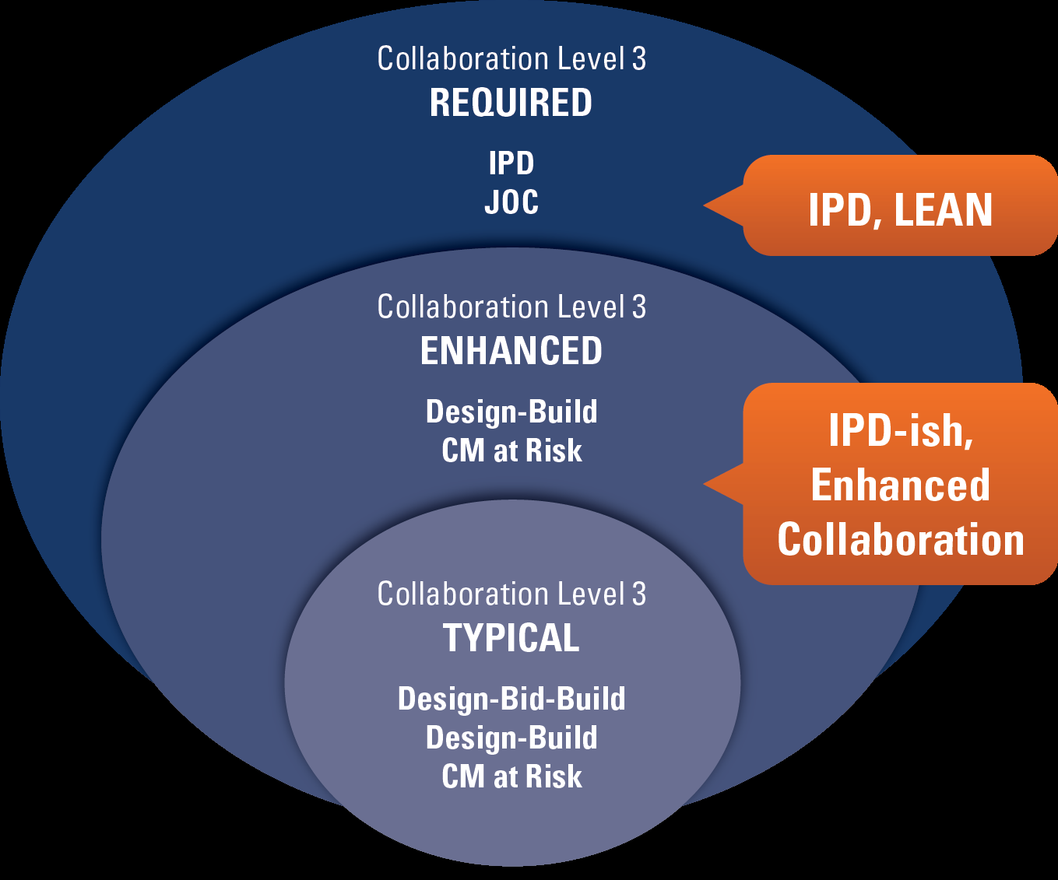
JOC / IPD and Levels of Collaboration

Slide 7
Comparison to Other Construction Delivery Methods

Slide 8
Job Order Contracting Users
Federal Government (DoD and non-DoD)
Higher & Secondary Education
State, County, and Local Government
Healthcare
Transportation (Airports, Mass Transit, Roadways and Bridges)

Slide 9
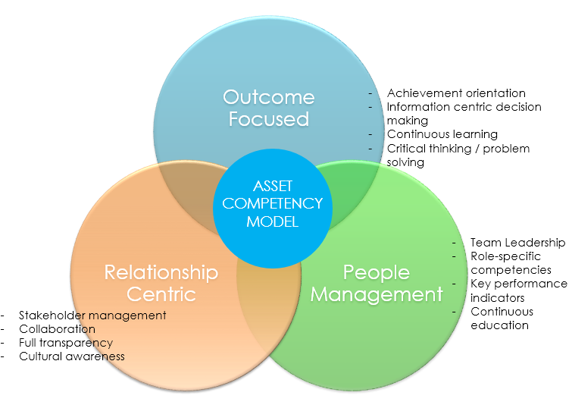
Job Order Contract Considerations
Primary goal(s)
Term (Generally 1 year with additional options years, up to five years total)
Maximum contract value (annual and overall total)
Maximum individual project size
Minimum payment to contractor
Available Owner resources and level of competence to manage
Deployment method: Owner-managed, Cooperative, or Outsourced
Best value selection/procurement capability
Availability of experienced JOC contractors
Key performance indicators (KPIs)
Availability of ongoing training
Supporting technology
Selection of UPB
Provisions for updating the UPB
Management of non-prepriced items (NPP) to cover unforeseen requirements
Regular JOC program audits
Items to be included in the co-efficient
Number and type of co-efficients
Provisions for bonding, liquidated damages, change orders, progress payments, warranties, and payment withholding.

Slide 10
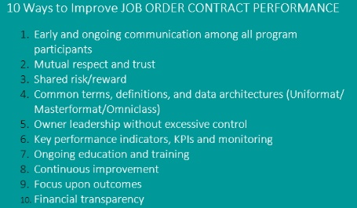
Uses for Job Order Contracting
Projects that are time sensitive
“Minor” construction projects (generally under $1-2 Million)
HVAC and Electrical
Routine repairs
Renovations of all types
Upgrades to ADA standards
Emergency repairs
Site work and utilities
Parks and playgrounds
Upgrade landscaping
Classroom additions
Complete new buildings
Replace flooring
Roofing
Communications
Fencing

Slide 11
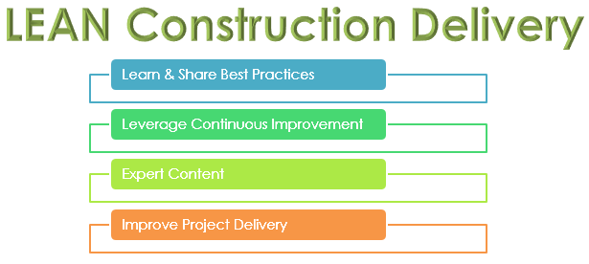
Benefits Job Order Contracting
90%+ of projects on-time
90%+ of project on-budget
Higher quality
Greater satisfaction among participants and users
Access to on-demand construction services
Significant reduction in change orders and legal disputes
Long term owner-contractor relationships
Improved productivity
Greater cost transparency
Cost visibility
Less “down-time” and fewer disruptions to building/asset users
Reduced risk and variance
Higher WBE/MBE participation
Greater percentage of dollars spend upon construction versus administration/waste

Slide 12
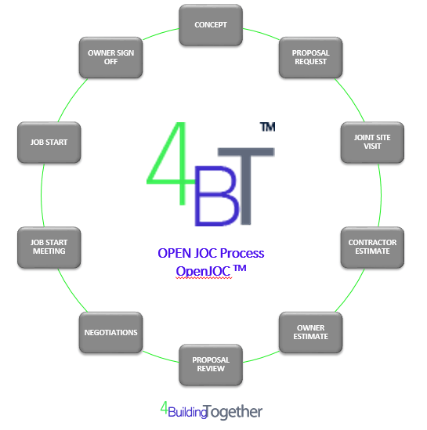
Job Order Contract Workflow
Initial Concept / Scoping Session
Internal Budgeting / Estimate
Contractor Proposal Request
Joint Site Visit
Contractor Estimate
Estimate Preparation
Owner/Contractor Estimate Comparison
Proposal Review / Negotiations
Notice to Proceed
Project Kickoff Meeting / Job Start
Regular Owner/Contractor Progress Meetings
Final Inspection
Close Out

Slide 13
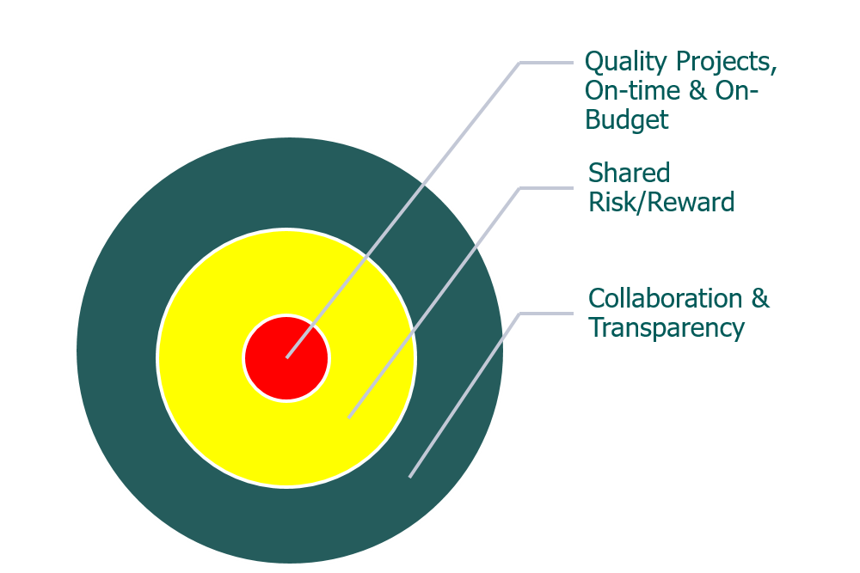
Initial Scoping & SOW Development
Assure all interested parties, participants, stakeholder are present
Funding availability and compliance
Establish project goals
Level of design services required
Existing plans or estimates
Building systems and quality of materials
Identify client, contractor, and building user responsibilities
Evaluate potential impacts to existing operations, including life/safety
Determine project schedule and major milestones
Safety, security and hazardous material issues
Timing
Permits
MBE/WBE goals
Review qualification and assumptions
Revise the scope as necessary
Confirm start/completion dates

Slide 14
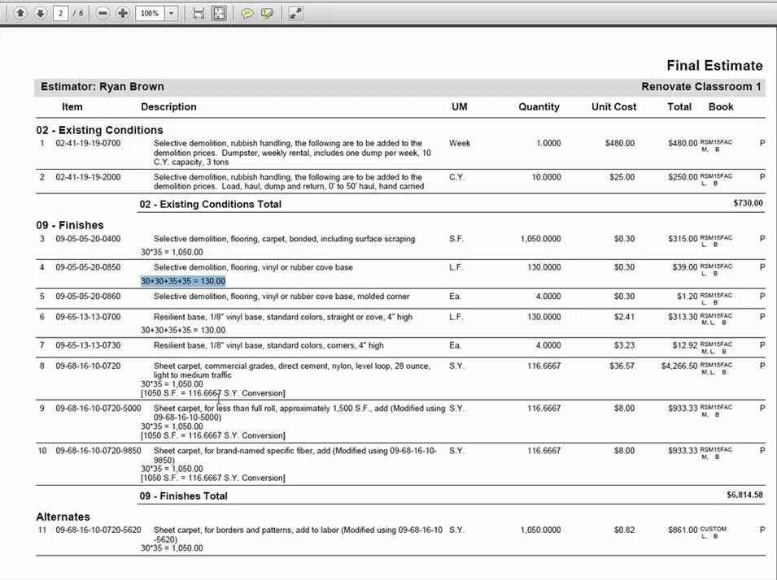
JOC Estimating
Sample – For reference purposes only
Select UPB – unit price book
Contractor and Owner jointly scope and provide quantities of work.
Contractor creates an estimate, and Owner prepares internal estimate or Internal Government Estimate (IGE) – for all projects or for projects over an established dollar value).
The totaled UPB line item estimates in the estimate are multiplied by the coefficient(s) designated and accepted.
A localization factor and/or economic index factor may also be applied, if applicable.

Slide 15
Use of a JOC Coefficient – Example
Example:
Total of UPB Line Items $45,328.10
Multiply by Coefficient (1.05) $47,594.51
Cost to Owner $47,594.51

Slide 16
Job Order Contracting & LEAN Construction Delivery – LESSONS LEARNED, Do’s & Don'ts
Focus upon outcomes
Owner / Owner’s representative must understand JOC and have direct involvement in the jobs & JOC process. JOC is not right for all Owners.
DO NOT use JOC as a method to bypass procurement, or approve projects that others wise would not be approved.
DO NOT pay a fee to a third party administrator or management firm to manage your JOC program that is tied to construction value. This represents a clear conflict of interest and presents a potential for fraud.
Allow adequate time for the JOC process, it’s a culture change.
Contractors invest a lot of front end effort, JOC is not for all contractors.
Owners can expect excellent execution of the work.
Contractors can expect a reasonable profit and long term owner relationship.

Slide 17
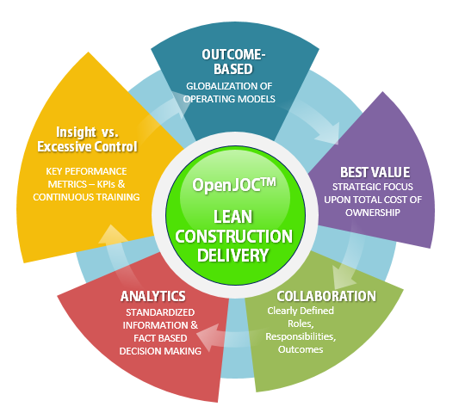
Owner’s Role in JOC
Provide LEADERSHIP
Treat Contractors as TEAM members and with RESPECT
Leverage the EXPERTISE of the contractor
Manage and MONITOR without EXCESSIVE CONTROL
Seek to CONTINUOUSLY IMPROVE KNOWLEDGE & PERFORMANCE
Assure COMPLIANACE with regulations/statues/Job Order Contract

Slide 18
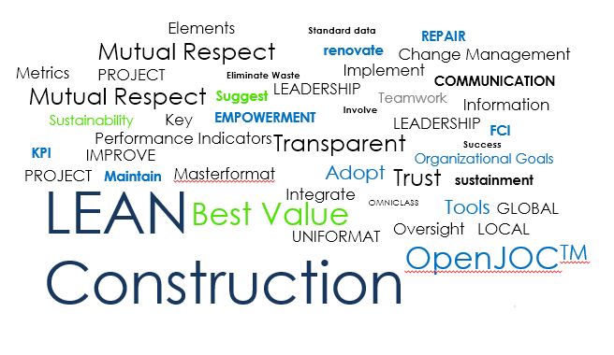
Contractors Role in JOC
Delivery QUALITY ON-DEMAND services
Collaborate with Owner
Assure financial TRANSPARENCY
Earn a REASONABLE profit
Remember this is a LONG TERM RELATIONSHIP
Meet all REPORTING requirements

Slide 19
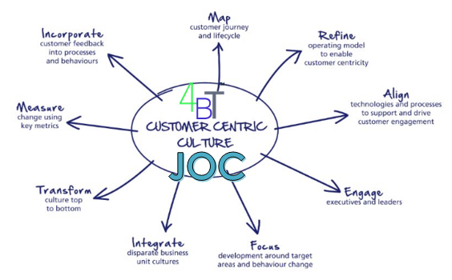
BEST PRACTICE, OPEN Job Order Contracting & Efficient Construction Project Delivery
www.4BT.US
www.jobordercontracting.org
info@4BT.US

